Slide 1
Stochastic Calculus for Finance 2023/06/27
游竣瑜

Slide 2
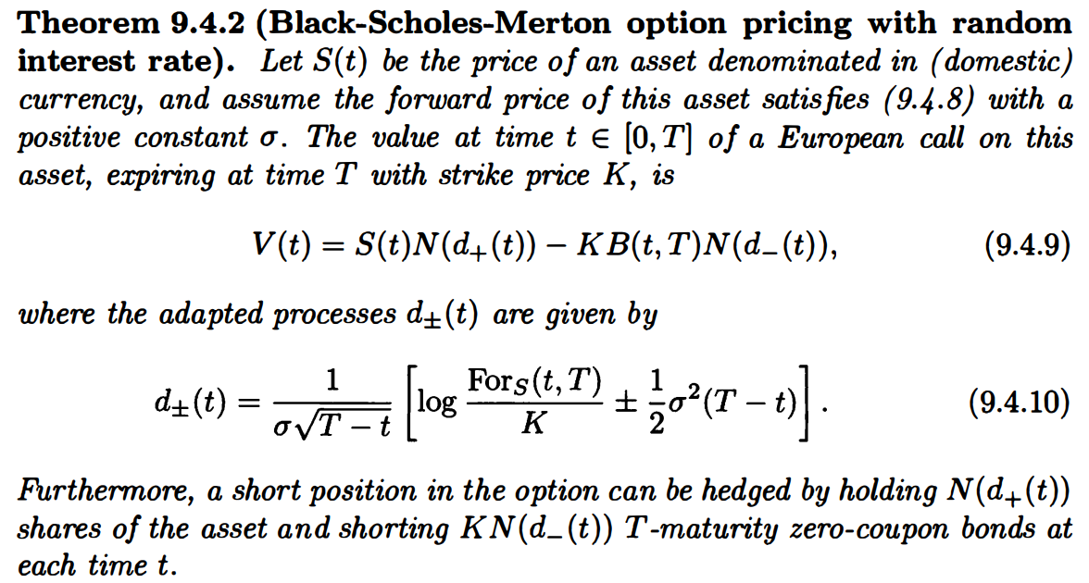

Slide 3
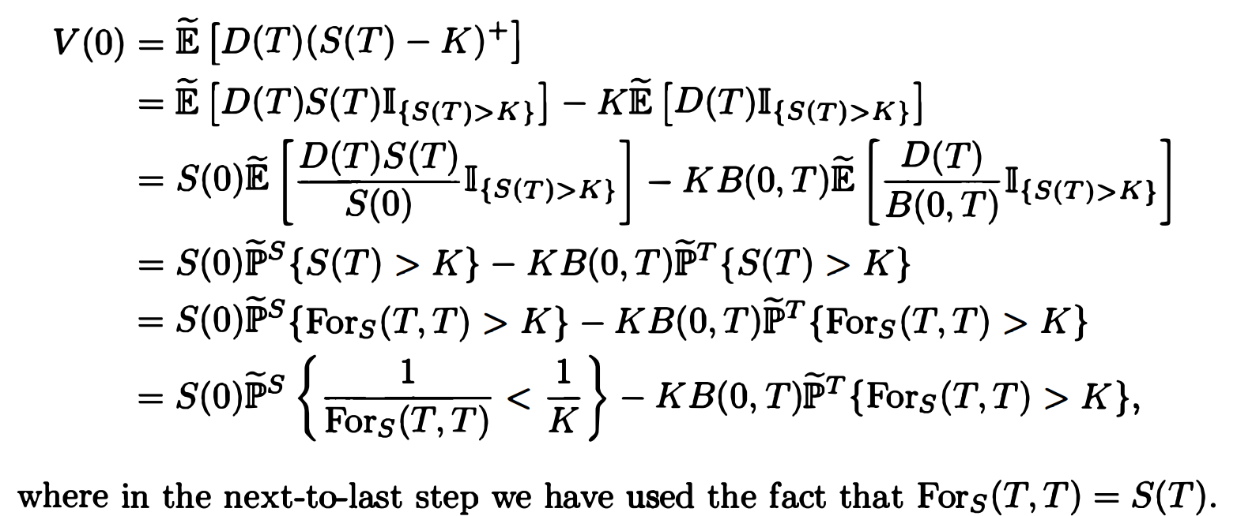




Slide 4
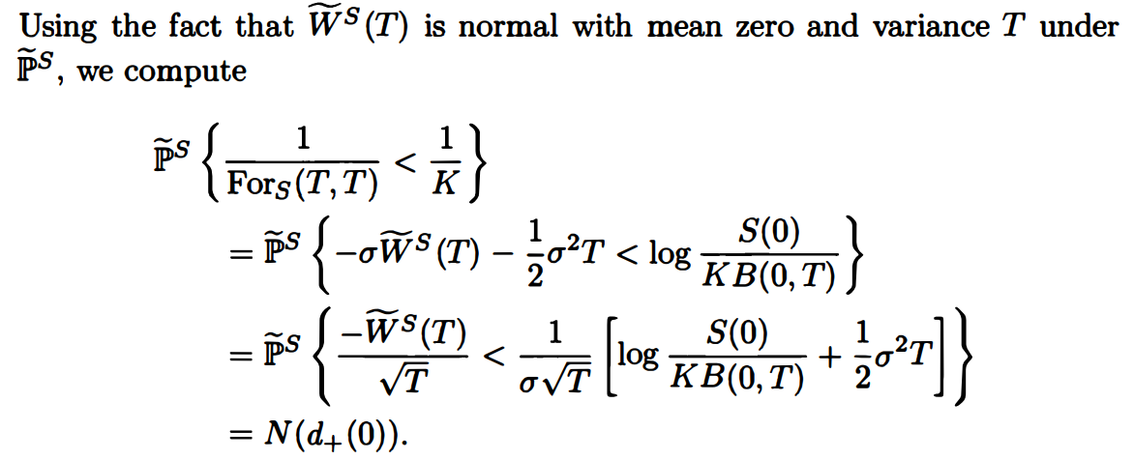



Slide 5
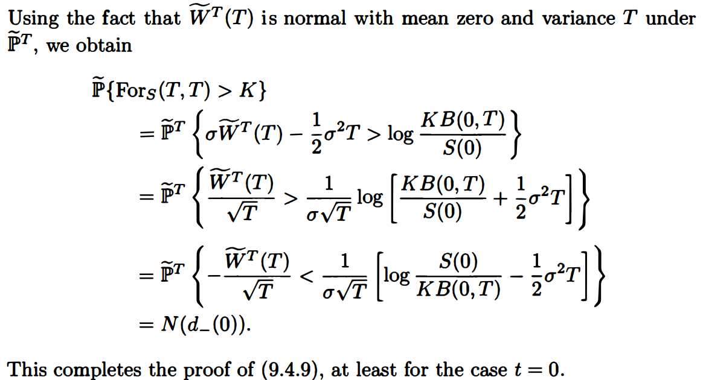


Slide 6
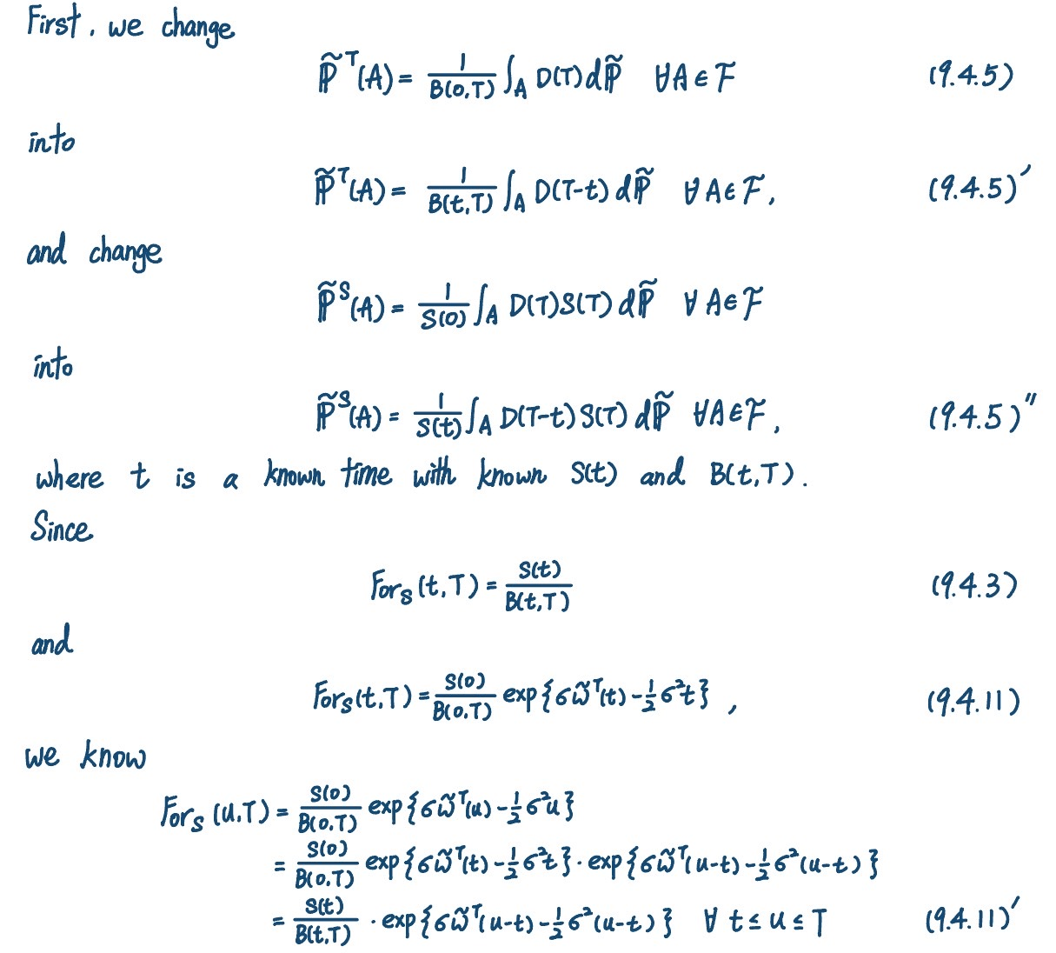

Slide 7


Slide 8
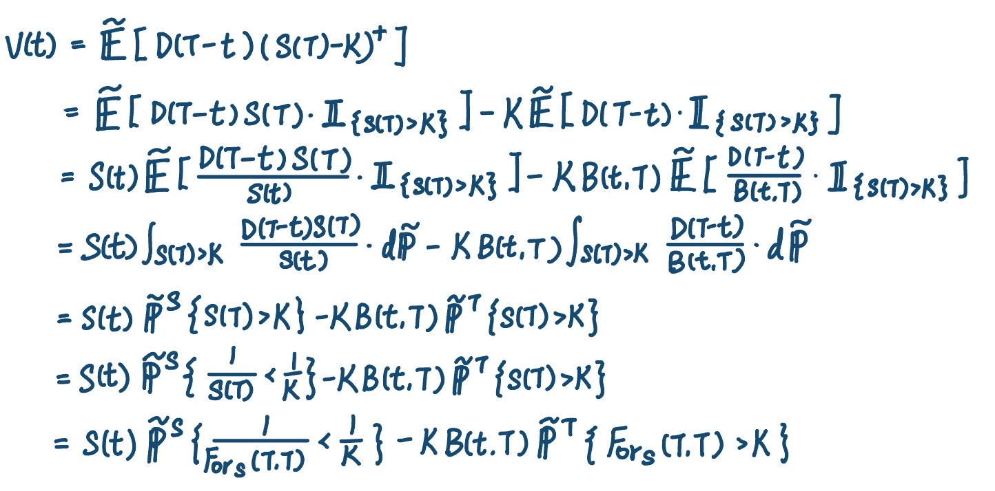

Slide 9
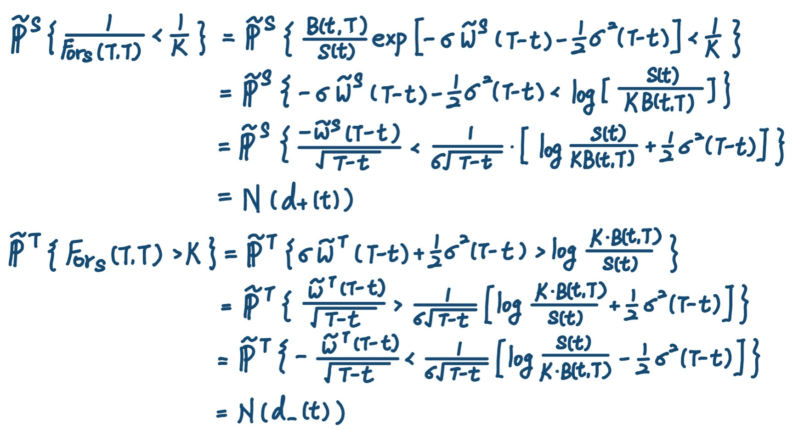

Slide 10




Slide 11
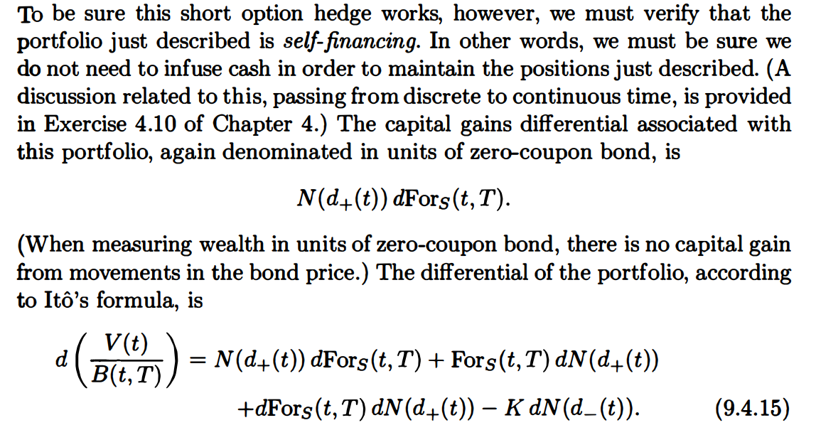

Slide 12
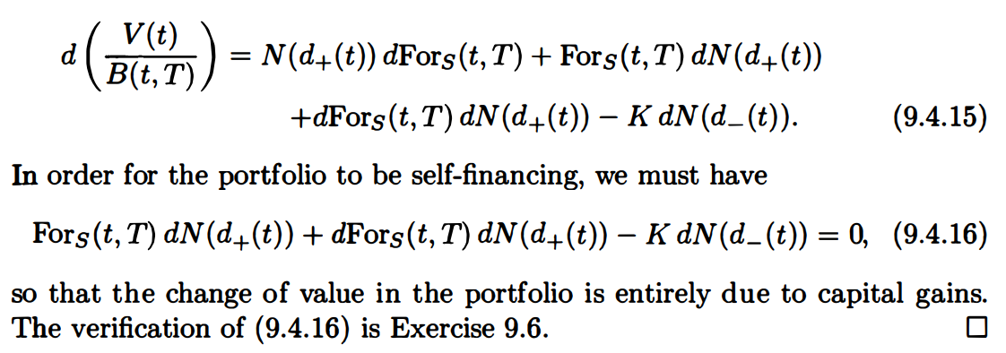

Slide 13
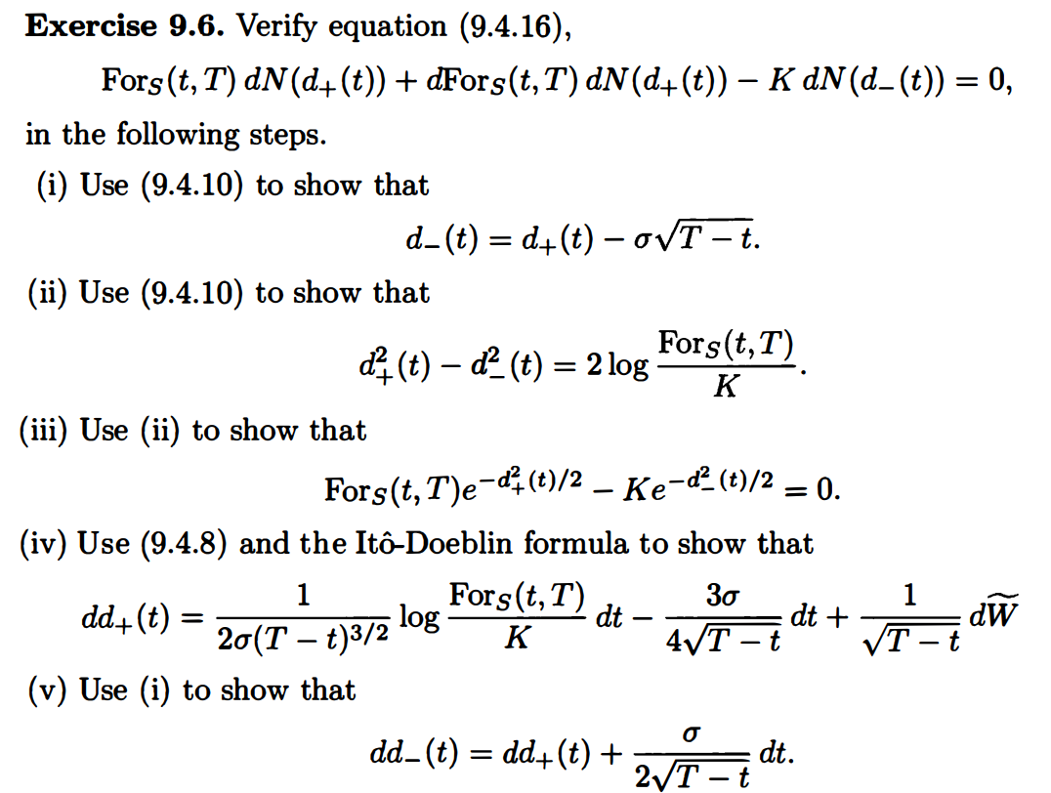

Slide 14
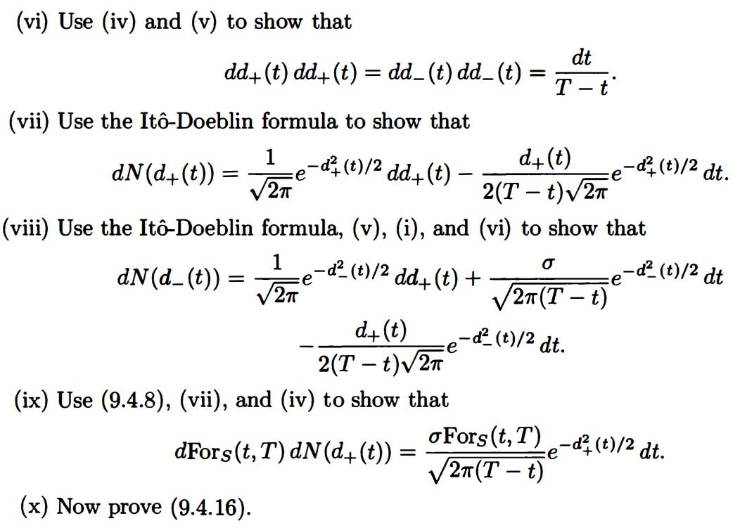

Slide 15
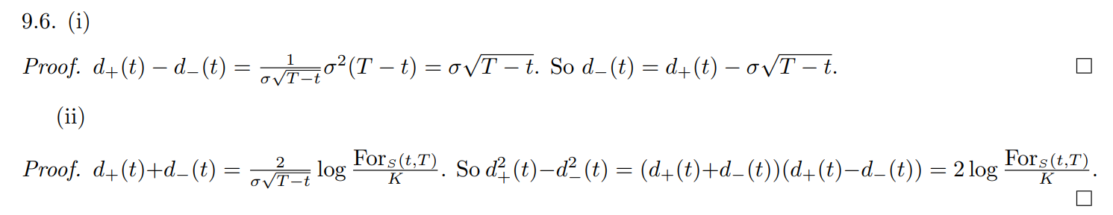

Slide 16


Slide 17
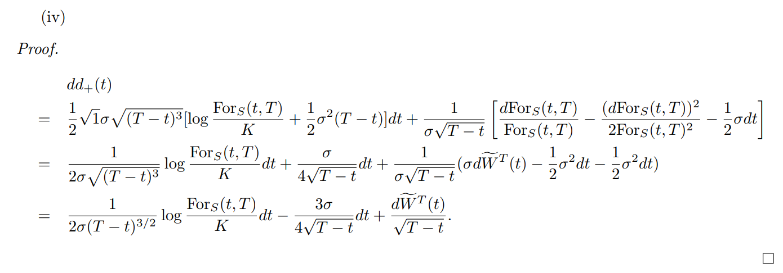


Slide 18


$$Standard Normal pdf:$$
$$f\left(x\right)= \frac{1}{\sqrt{2π}}e^{{−x^{2}}/2}, ∀x∈R$$

Slide 19

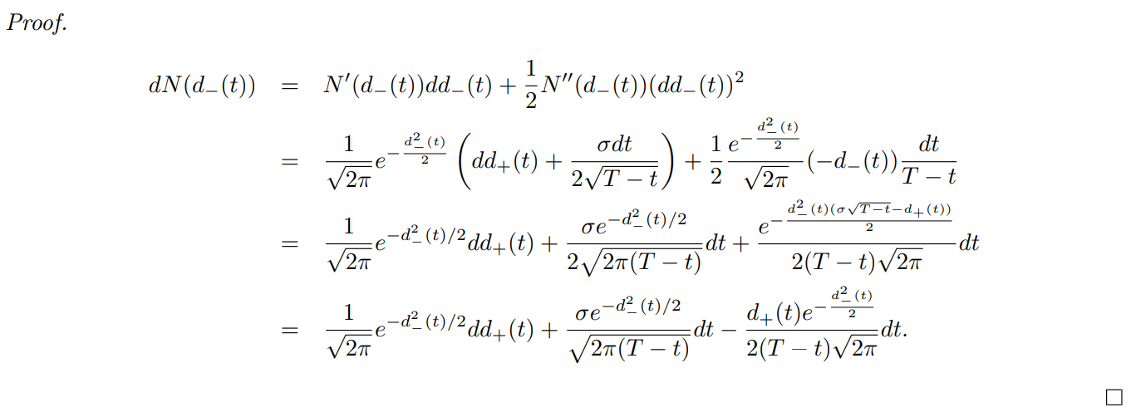

Slide 20


Slide 21
